Slide 1
PROJECT TITLE: BIKE CRASH DETECTION
PIP104 University Project-II
Review-1
Batch Number:CSE-G177
Roll Number | Student Name
20201CSE0849 | Harshith N R
20201CSE0853 | Abhi Kiran
20201CSE0870 | Shiva Kumar
20201CSE0875 | Eshwar Raju A G
Under the Supervision of,
Mr. Afroz Alam
Assistant Professor
School of Computer Science & Engineering
Presidency University

Slide 2
Introduction
Globally, road traffic accidents are a major public health concern. According to the World Health Organization (WHO), approximately 1.35 million people die each year as a result of road traffic accidents, and motorcycles account for a significant proportion of these fatalities. Many of these deaths occur due to delays in emergency response and lack of immediate medical attention.
In both India and worldwide, the timely detection of crashes and the prompt dispatch of emergency services can play a crucial role in reducing the severity of injuries and saving lives. Advanced technologies, such as crash detection systems, aim to address this issue by facilitating quicker response times in the event of accidents.

Slide 3
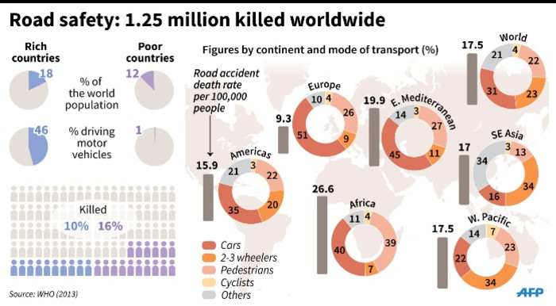
Introduction

Slide 4
Literature Survey
1.Vehicle Accident Detection & Alert System using IoT and Artificial Intelligence
https://ieeexplore.ieee.org/document/9544940
2.IoT-Based Vehicular Accident Detection Systems
https://www.researchgate.net/publication/349705527_IoTBased_Vehicular_Accident_Detection_Systems
3.Accident Detection and Alerting Systems: A Study
https://www.researchgate.net/publication/362264272_Accident_Detection_and_Alerting_Systems_A_Study
4. Research paper on vehicle detection and recognition
https://www.researchgate.net/publication/344668186_Research_paper_on_vehicle_detection_and_recognition
5.Intelligent Accident Identification and Prevention System Using GPS and GSM Modem
https://www.academia.edu/36122822/Intelligent_Accident_Identification_and_Prevention_System_Using_GPS_and_GSM_Modem

Slide 5
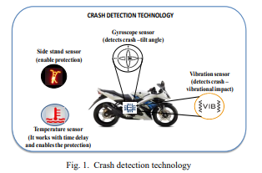
Proposed Method
For Bike Accident Detection:
a) Crash Detection Technology:

Slide 6
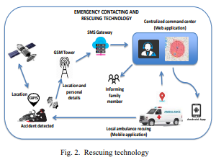
Proposed Method
For Bike Accident Detection:
b) Rescuing technology:

Slide 7
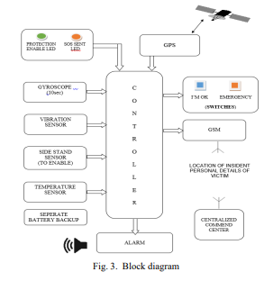
Proposed Method
For Bike Accident Detection:
c) Block Diagram:

Slide 8
Objectives
Enhance Road Safety
Improve Emergency Response
Prevent Vehicle Theft and Enhance Security
Optimize System Integration
Raise Awareness and Education
Evaluate and Improve

Slide 9
Existing Methods-Drawbacks
No GPS signal at the time of the crash.
• Insufficient cellular signal to upload crash details.
Accident report is not accurate
• Failure due to single point Manual system
• 3rd Party involvement
• Respond to only one contact number at a time.
Large Hardware and No specific application for Live location Tracking.

Slide 10
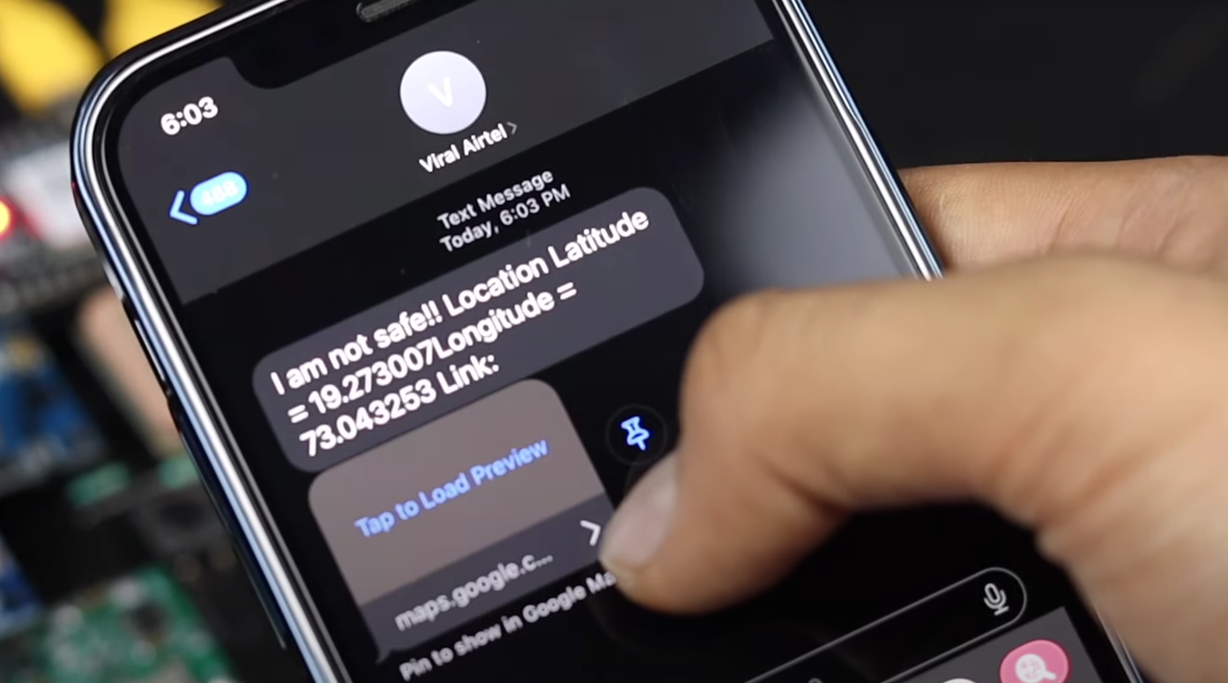
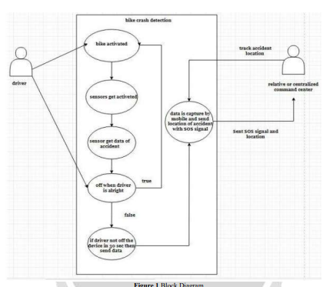
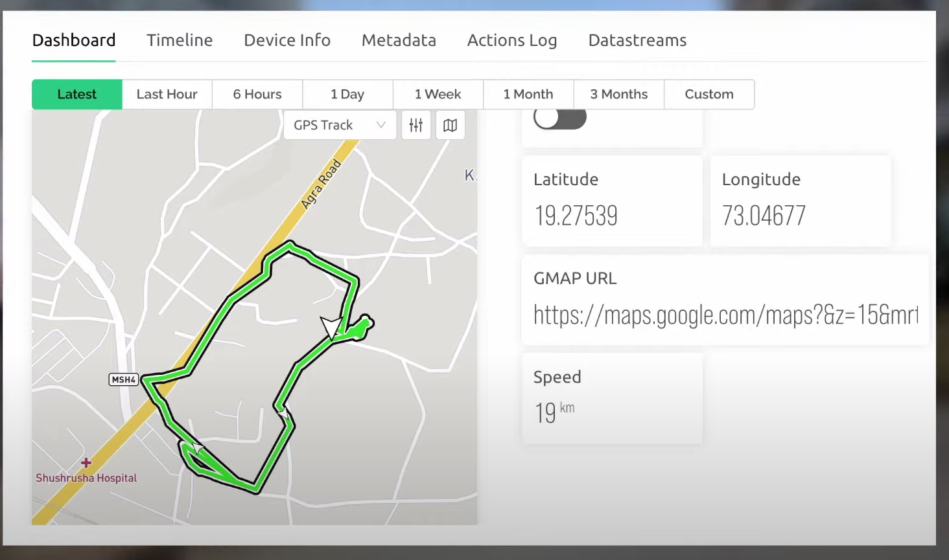
Methodology

Slide 11
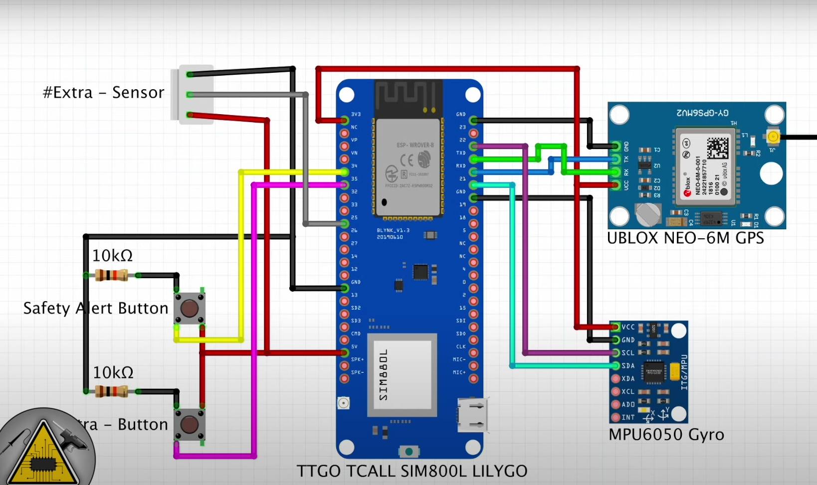
Architecture Diagram

Slide 12
Modules
Data Collection Module
Crash Detection Algorithm Module
Alert Generation Module
Communication Module
Testing and Validation Module
Continuous Improvement Module

Slide 13
COMPONENTS
HARDWARE: . Software Used
1.Arduino Nano 1. Arduino IDE
2.ADXL-345
3.GSM SIM800l
4.LM2596 Step Converter
5.GPS Neo-6m
6.Zero PCB

Slide 14
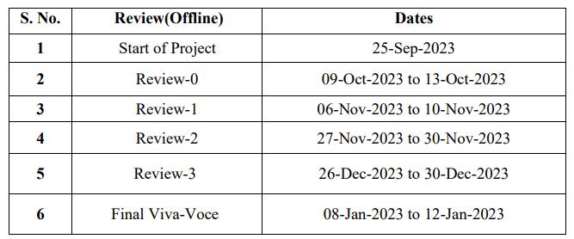
Timeline of Project
.

Slide 15
Expected Outcomes
Improved Accuracy in Crash Detection
Reduced False Positives and Negatives
Efficient Sensor Integration
Enhanced Emergency Response Time
User-Friendly Implementation
Versatility Across Transportation Modes
Integration with Existing Infrastructure
Real-world Testing and Validation
Data-driven Insights
Public Awareness and Adoption
Collaboration Opportunities

Slide 16
Conclusion
Innovative Safety Solutions:
Cutting-edge technologies offer a new era in vehicle crash detection.
Rapid Emergency Response:
Reduced response time crucial for saving lives after accidents.
User-Centric Approach:
User-friendly implementations enhance the adoption of safety measures.
Collaboration for Impact:
Partnerships with stakeholders amplify the effectiveness of crash detection systems.
A Road to Safer Journeys:
Vehicle crash detection systems pave the way for a safer future.

Slide 17
References
1.Vehicle Accident Detection & Alert System using IoT and Artificial Intelligence
https://ieeexplore.ieee.org/document/9544940
2.IoT-Based Vehicular Accident Detection Systems
https://www.researchgate.net/publication/349705527_IoTBased_Vehicular_Accident_Detection_Systems
3.Accident Detection and Alerting Systems: A Study
https://www.researchgate.net/publication/362264272_Accident_Detection_and_Alerting_Systems_A_Study
4. Research paper on vehicle detection and recognition
https://www.researchgate.net/publication/344668186_Research_paper_on_vehicle_detection_and_recognition
5.Intelligent Accident Identification and Prevention System Using GPS and GSM Modem
https://www.academia.edu/36122822/Intelligent_Accident_Identification_and_Prevention_System_Using_GPS_and_GSM_Modem

Slide 18
.
Thank You

